Slide 1

Group 11 – Bitcoin dataset
Team Members: Akshita Chooramani and Afreen Shakeel

Slide 2
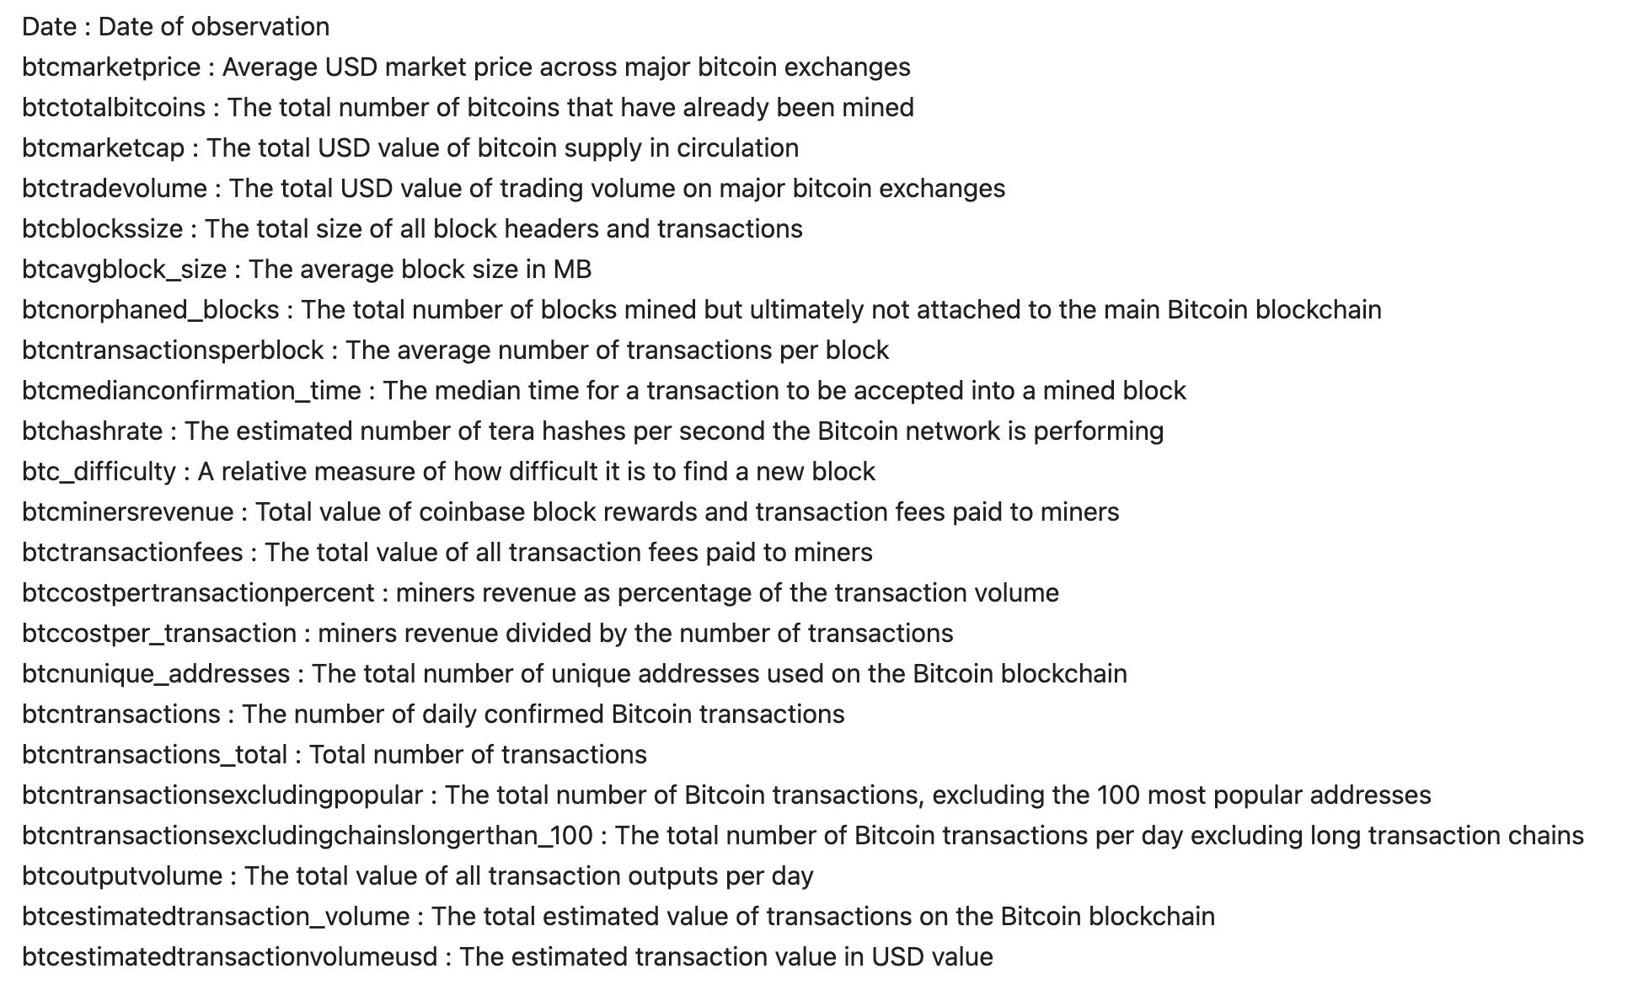
1. Describe your dataset

Slide 3
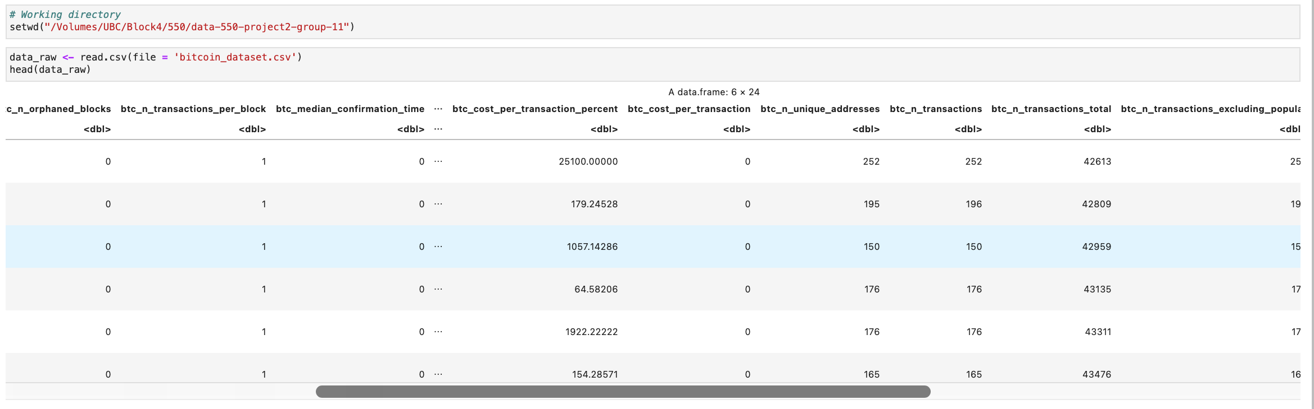
2. Load the data set

Slide 4
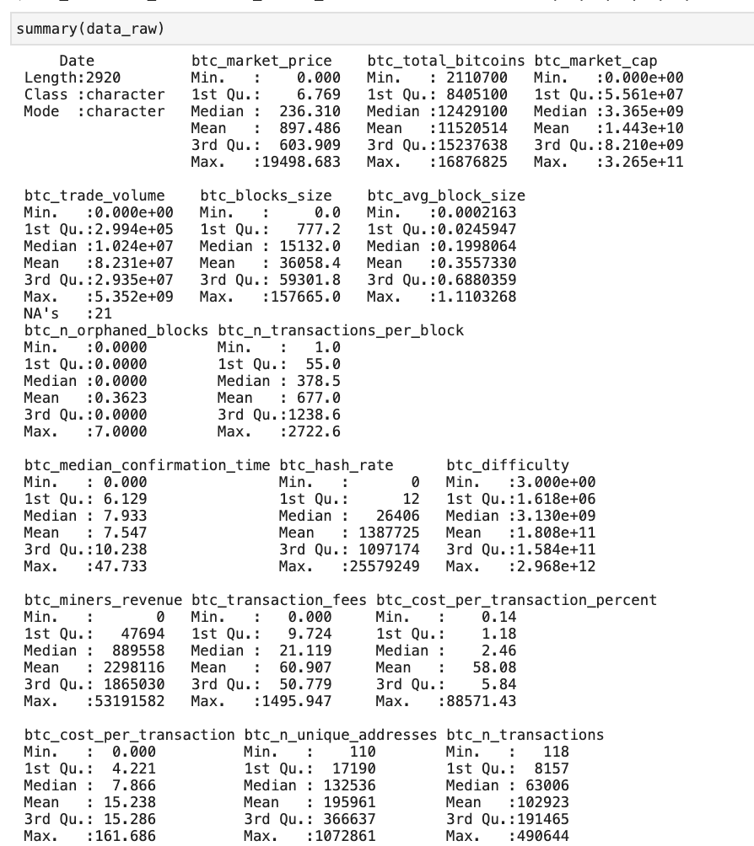
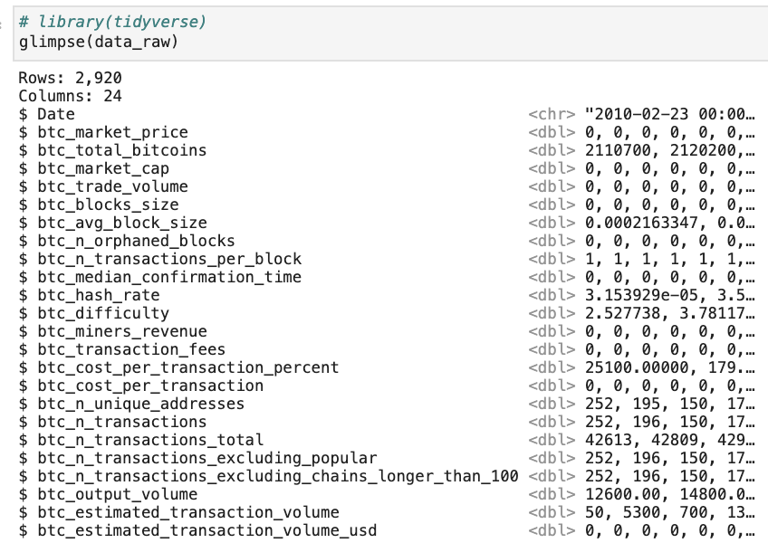
3. Explore the data set

Slide 5

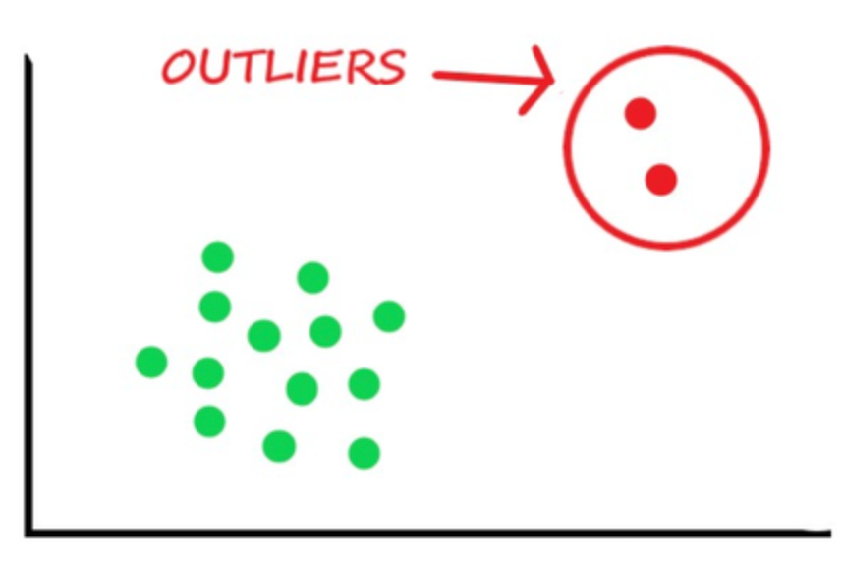
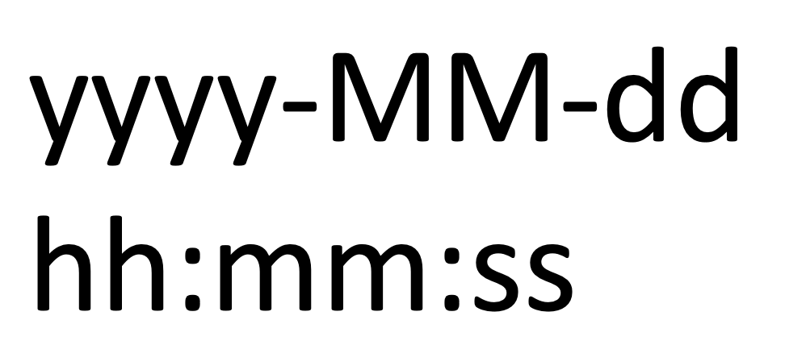
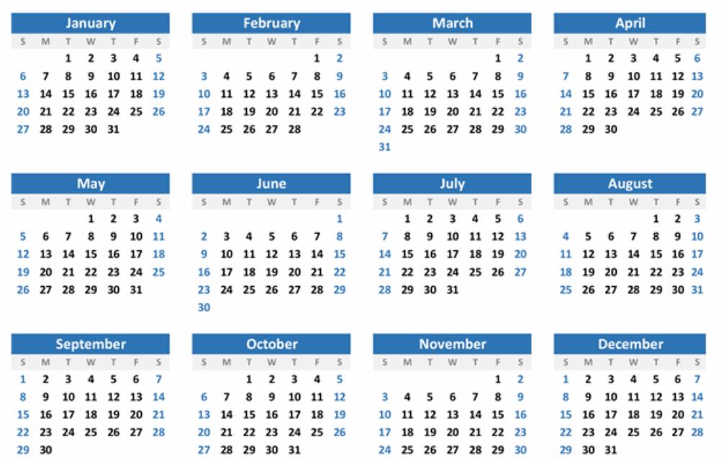

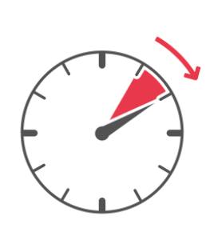
4. Initial thoughts

Slide 6
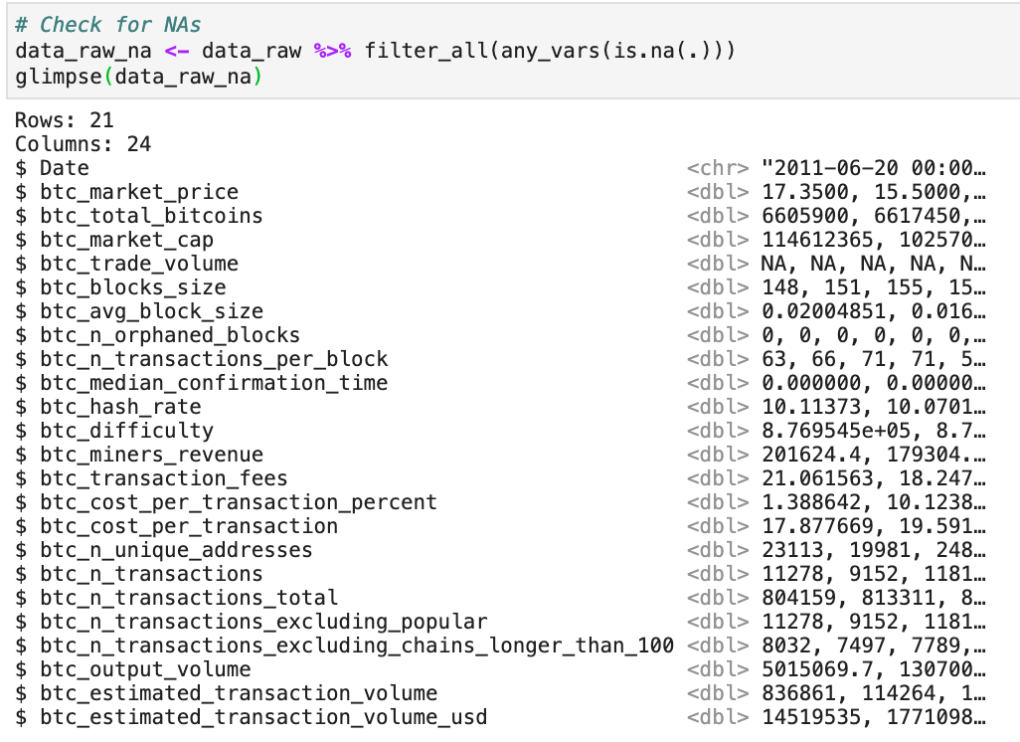
5. Wrangling

Slide 7
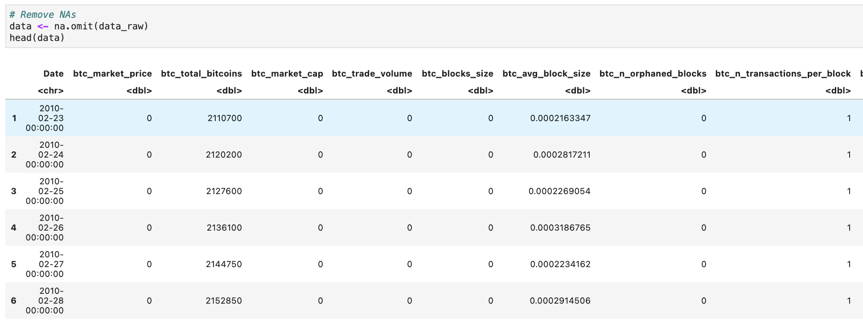
5. Wrangling

Slide 8
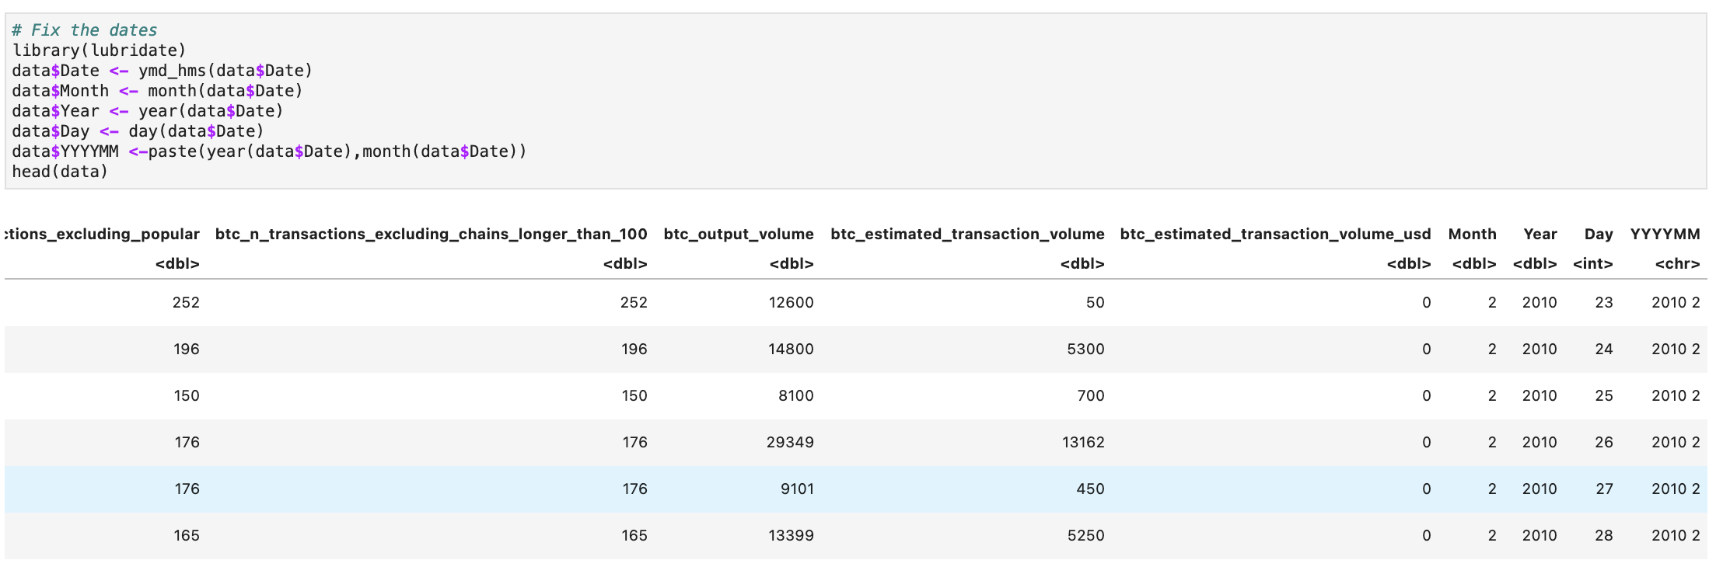
5. Wrangling

Slide 9
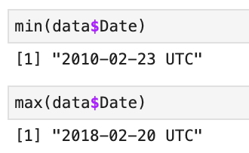
5. Wrangling

Slide 10
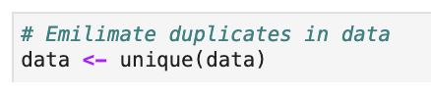
5. Wrangling

Slide 11
5. Wrangling

Slide 12
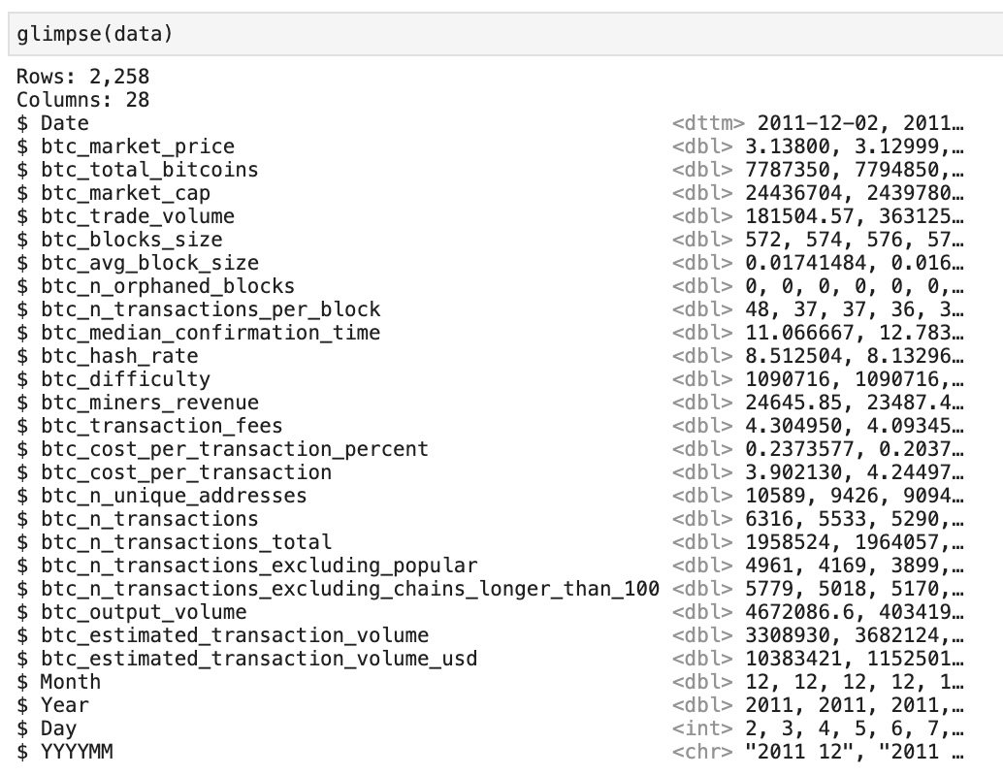
5. Wrangling

Slide 13
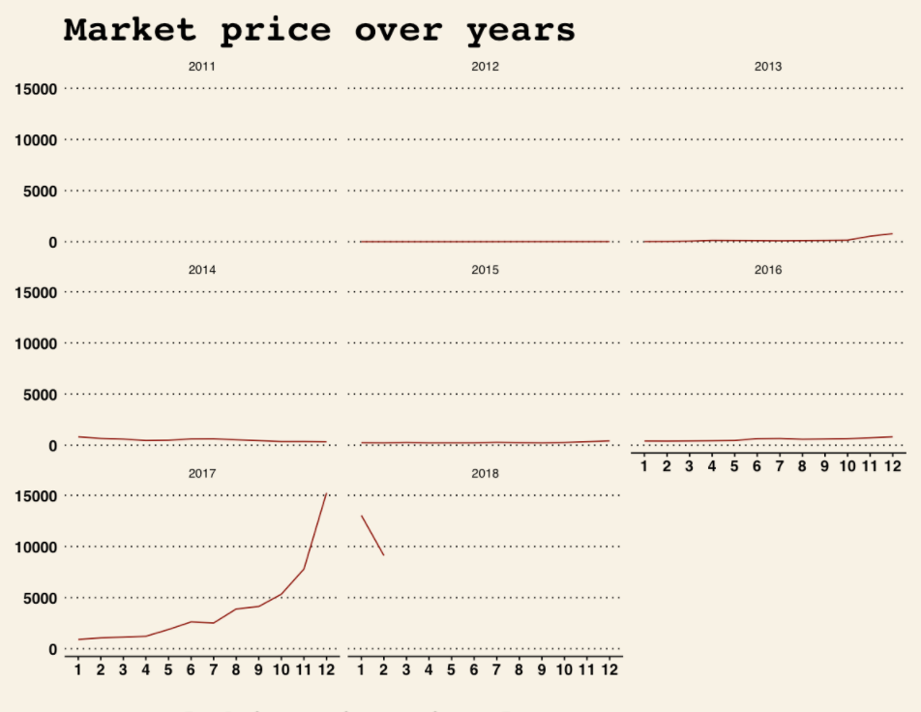
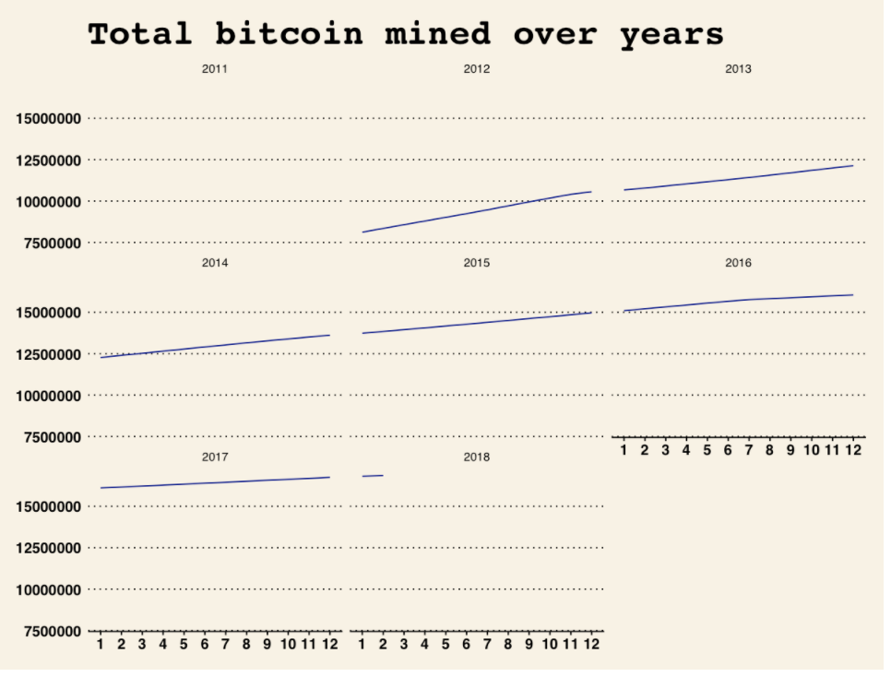
5. Wrangling

Slide 14
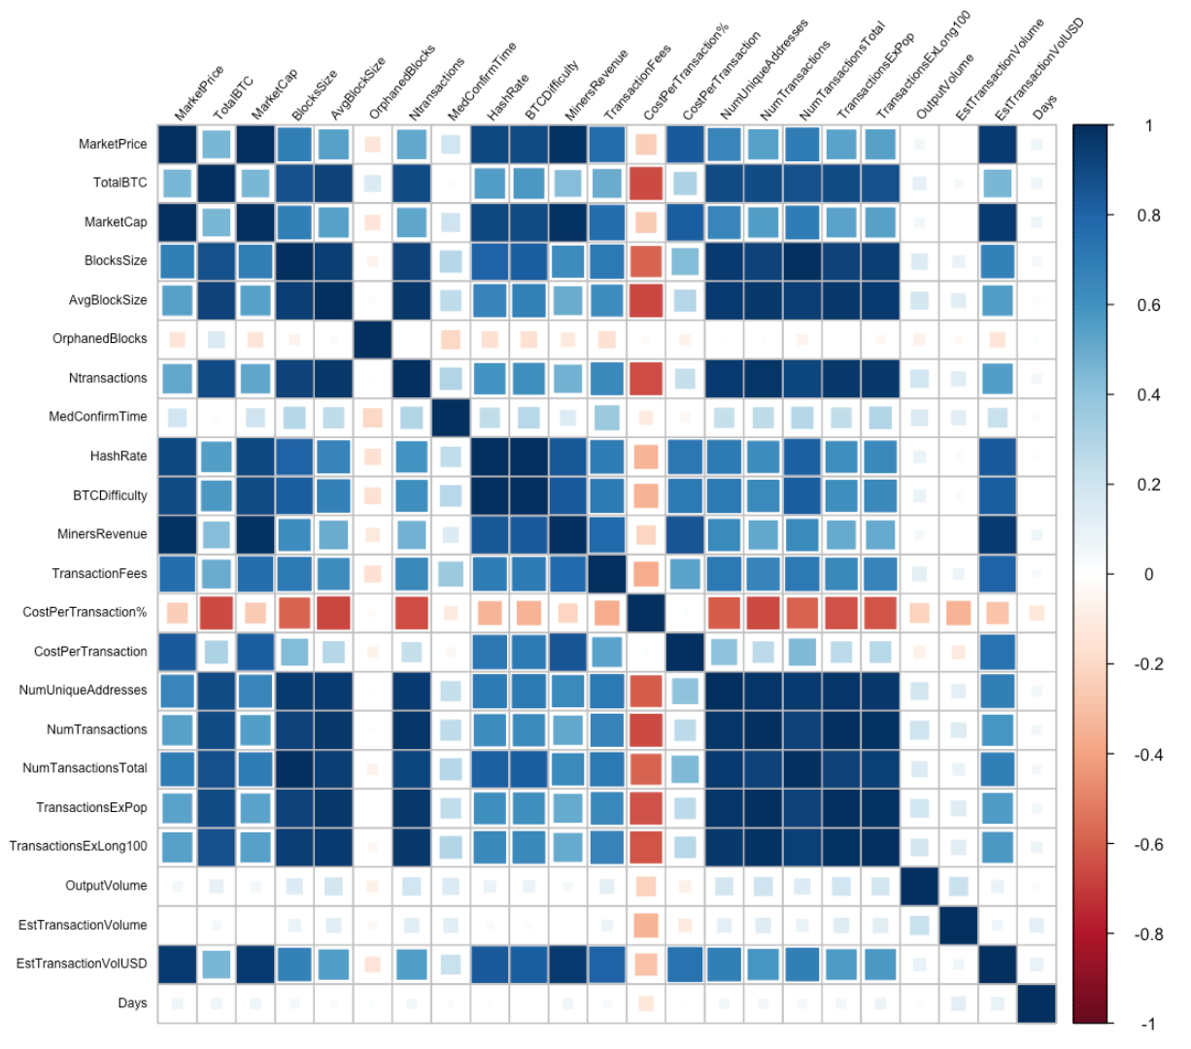
5. Wrangling

Slide 15
6. Research Question & 7. Data analysis & visualization

Slide 16
Part 1
Is there a correlation between
the total USD value of bitcoin supply in circulation (btc_market_cap)
and
average USD market price across major bitcoin exchanges (btc_market_price)?

Slide 17
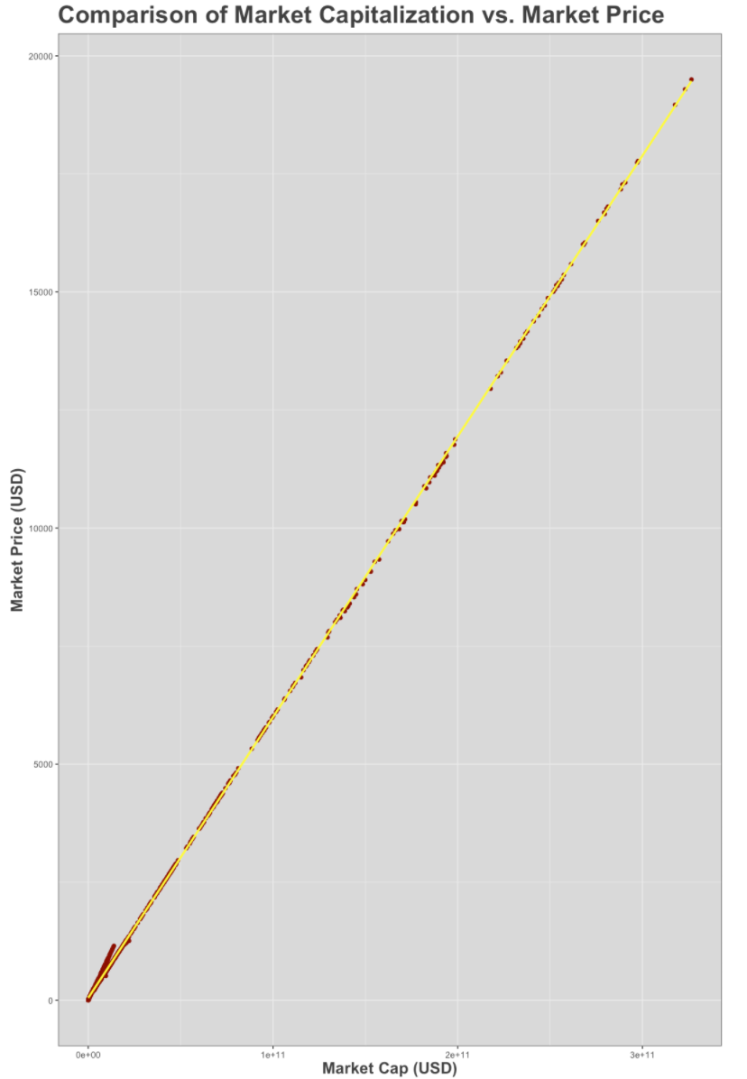
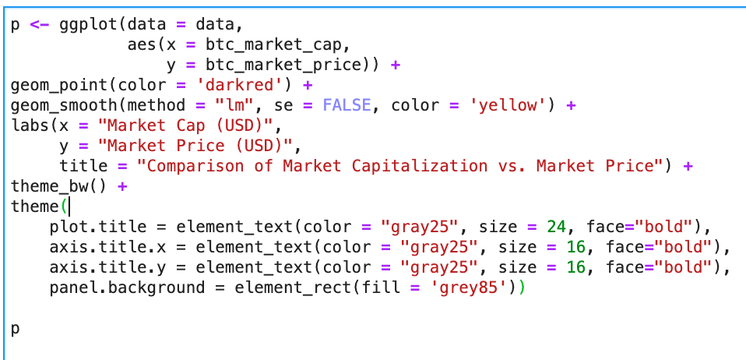

Slide 18
Part 2
Is there a correlation between
Total value of coinbase block rewards and transaction fees paid to miners (btc_miners_revenue)
and
average USD market price across major bitcoin exchanges (btc_market_price)?

Slide 19
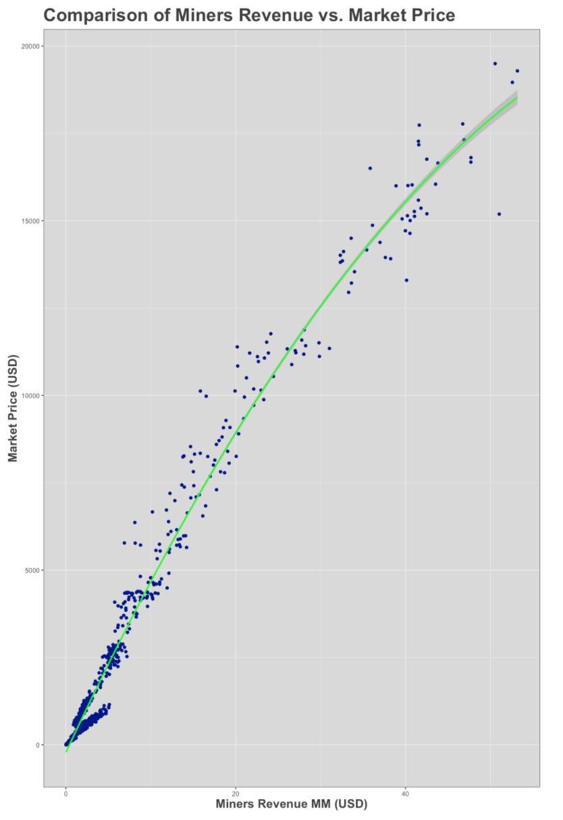
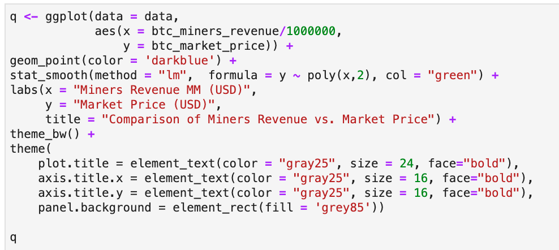

Slide 20

8. Summary and Conclusion

